Slide 1

Predicting Student Success Using Machine Learning
Presenters:
Syed Miran Hussain
Yasmin Saniya Tabassum
Mohammed Huzaifa
Lords Institute of Engineering and Technology
Date: [04/01/2025]

Slide 2
The Challenge of Early Intervention
Predicting student performance is critical for providing timely support.
Problem Statement
Objective
Early identification of at-risk students is essential.
Develop a machine learning model to predict student success.

Slide 3
Leveraging Machine Learning for Education
Building on existing research, we aim to enhance model interpretability and actionability.
Existing Work
Our Approach
Decision Trees and Neural Networks have been applied.
Focus on interpretable insights to guide interventions.

Slide 4

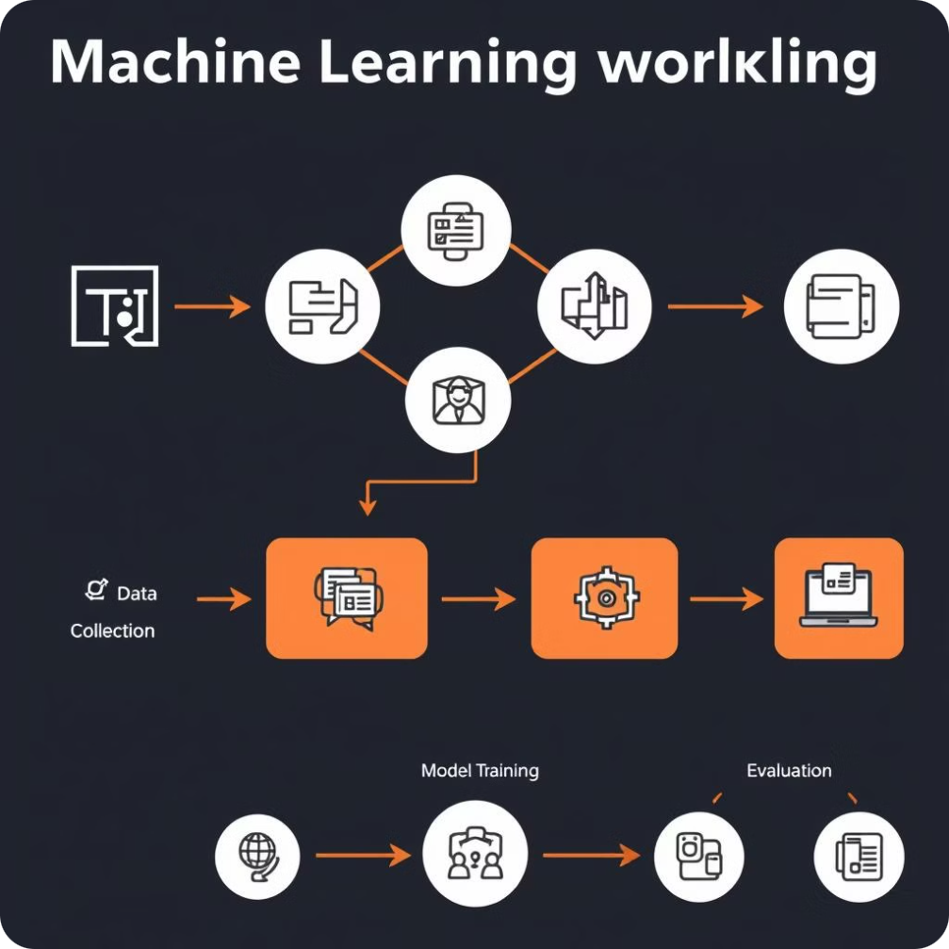
System Design: A Comprehensive Workflow
From data collection to model evaluation, we ensure a robust and transparent process.
1
Data Collection
2
Preprocessing
3
Model Training
4
Evaluation

Slide 5
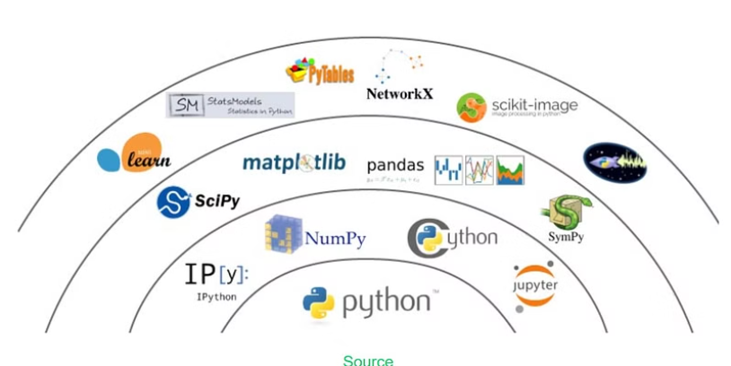
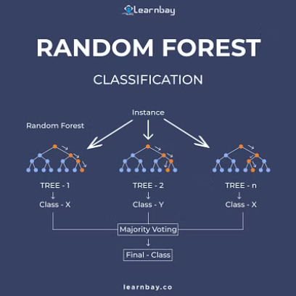
Methodology: Data and Model Selection
We utilize a diverse dataset and robust machine learning algorithms.
Dataset Features
Models Used
Tools
Attendance, grades, parental education, study habits.
Logistic Regression, Random Forest.
Python, Scikit-learn, and Matplotlib are our tools of choice for data analysis, model building, and visualization.

Slide 6
Testing and Results
Inputs
Outputs
Student details: academic performance, attendance records, and other relevant factors
Predicted performance category (e.g., “At Risk”, "Moderate Risk", or "Low Risk")

Slide 7
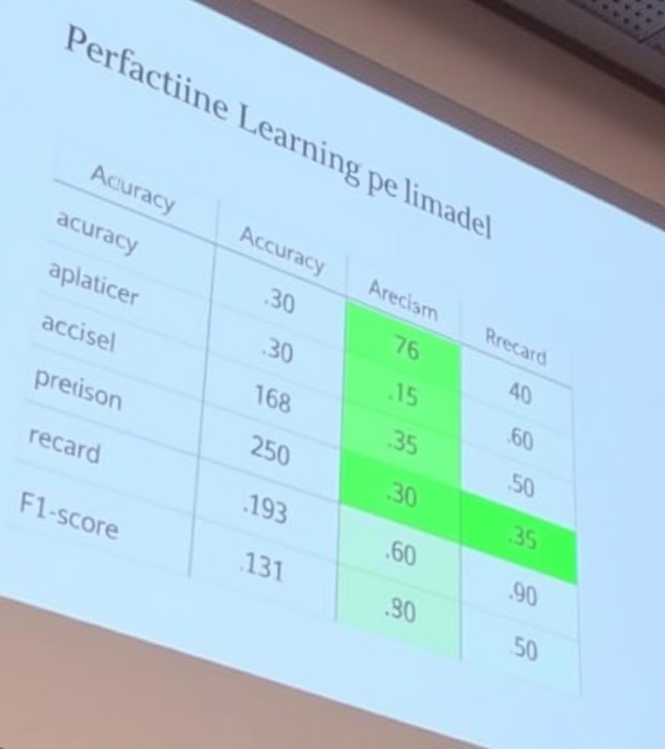


Implementation: A Powerful Predictor
Our model delivers accurate predictions for student performance.
Metrics
Test Case
We evaluate the model's performance using common metrics, including accuracy, precision, recall, and F1-score. These metrics provide a comprehensive assessment of the model's accuracy and effectiveness.
For a student with 75% attendance, our model predicts a "Moderate Risk" category. This suggests a potential need for additional support or interventions to ensure success.

Slide 8

Evaluation: Validating Our Model
Rigorous testing ensures the reliability and effectiveness of our predictions. Our model achieved an :
92%
89%
Accuracy
Precision
High accuracy in identifying at-risk students.
Minimizing false positives.
91%
Recall
Maximizing identification of at-risk students.

Slide 9
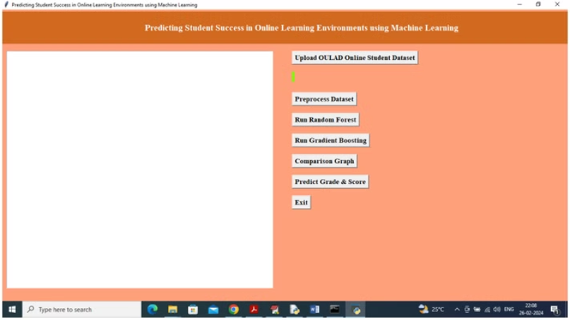
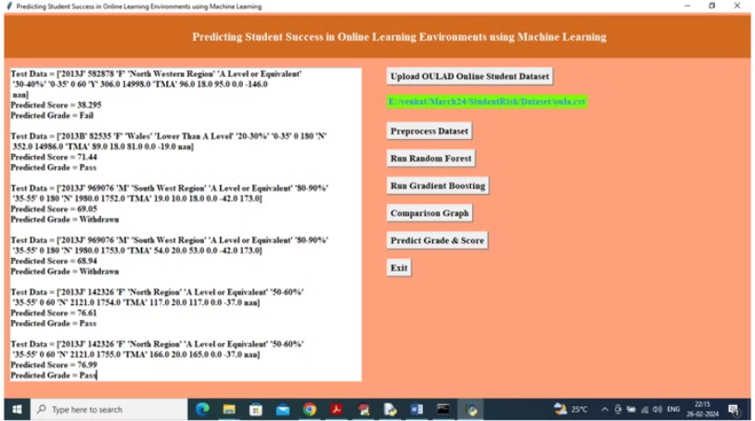

Slide 10


Conclusion and Future Directions
Our model paves the way for improved student support and success.
Conclusion
1
Accurate predictions for identifying at-risk students.
2
Future Work
Real-time data integration, incorporating psychological factors.

Slide 11

References
A strong foundation for our research.
“Student Success Prediction Using ML,” Journal of Educational Data Mining.
Scikit-learn documentation: https://scikit-learn.org.

